Slide 1
Communications Update
UKWF Regional Meeting 5th October 2023

Slide 2

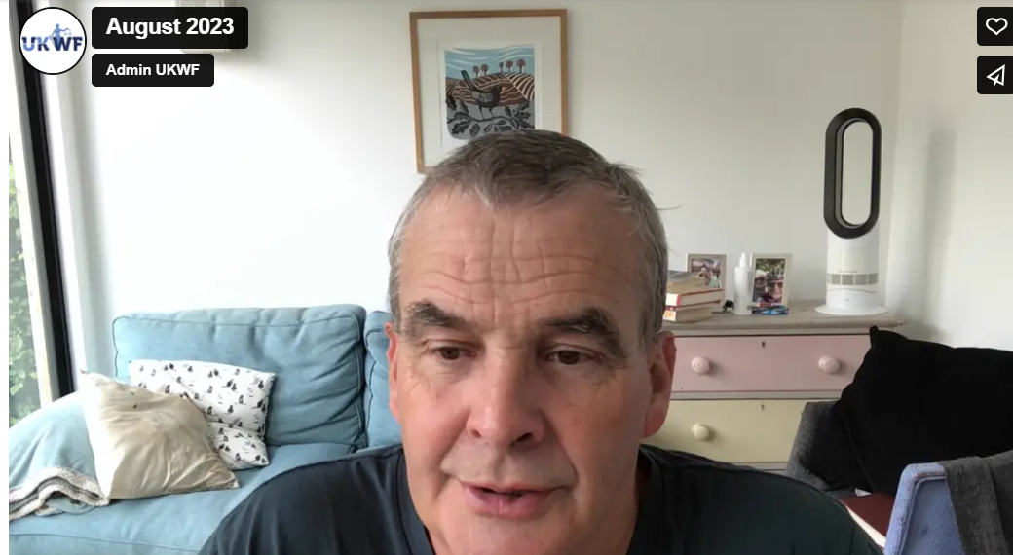
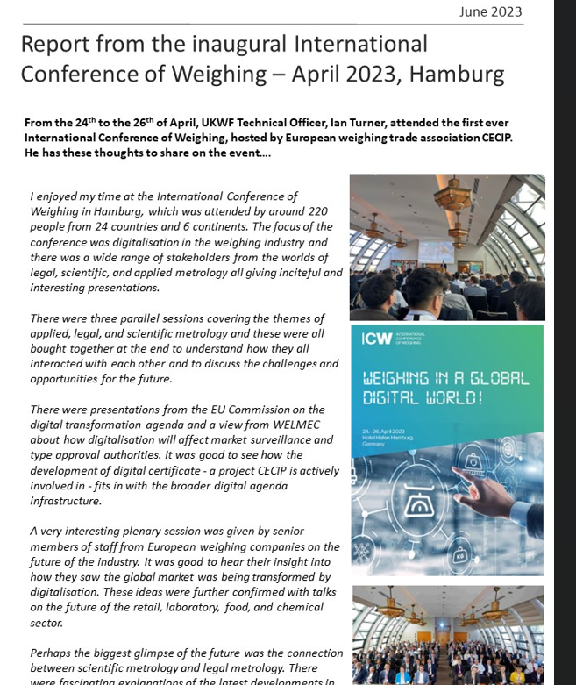
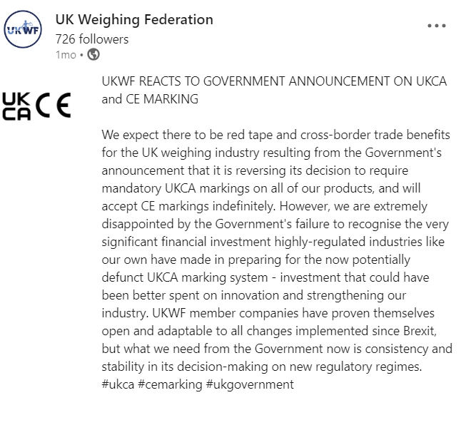


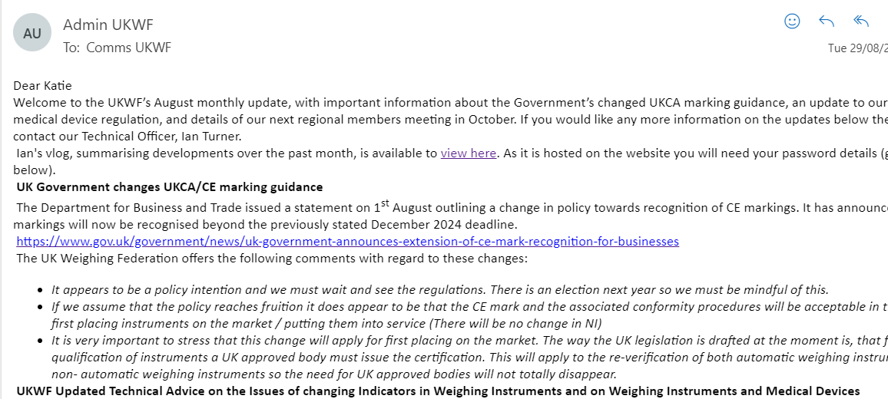
Our Comms Activity: Business as usual
Monthly Updates
Ian’s Vlog
2x newsletters have gone out
September Technical Webinar
Social media growth – 726 LinkedIn followers.
      © UK Weighing Federation

Slide 3
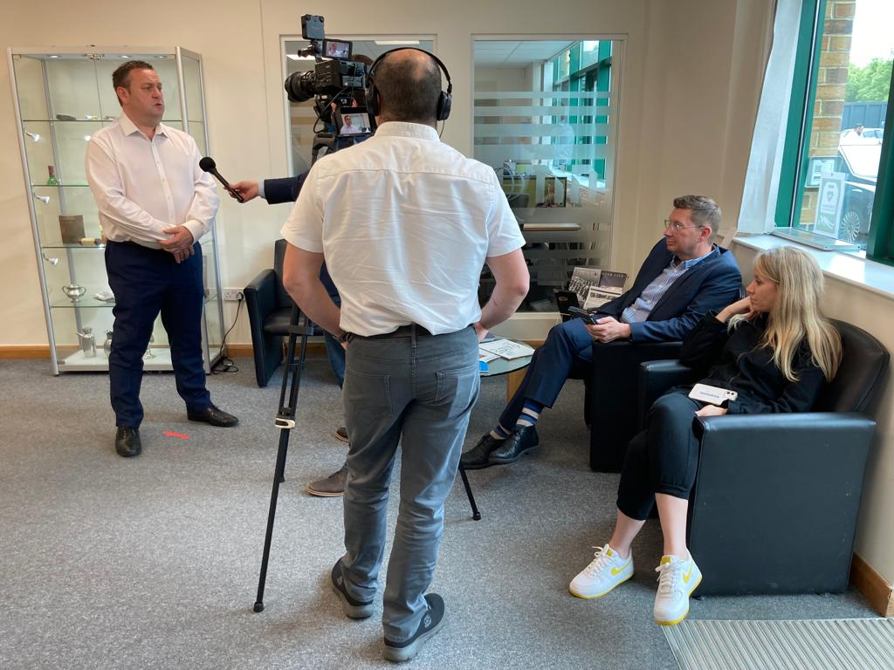

Our Comms Activity: Priorities
Media Preparedness
Held a Board Directors media training day in April, run by professional media trainers and journalists
Participants reported feeling more prepared and confident in print and broadcast media interviews.
UKWF now has some media messaging, and a media contact map
CTSI
We have launched our CTSI Open Day Training Offer, with most days currently available being fully or nearly fully booked. More days have been requested.
We have kicked off our policy project with CTSI, which will outline the importance of good regulation of weights and measures for consumers, our industry, businesses and Government.
Website
Supported Tom Marren with the new UKWF website development.
      © UK Weighing Federation

Slide 4


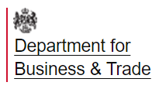



Our Comms Activity: External affairs
Retained EU Law Bill
Government removed the sunset clause and is instead focusing on a smaller list of regulations which will be removed from the statute book by December. Not likely any weights and measures regulations will be immediately impacted.
Government Engagement
Ian has engaged with Government to try and understand impact of UKCA marking requirement changes
We have met with DfBT, and their new Head of Legal Metrology Policy, on future regulations
Stakeholder Engagement
Met with GAMBICA to understand new regulatory developments and understand carbon reporting offer
Joined MAKE UK to offer new benefits to members and
Continued to work with CECIP on European regulatory affairs
      © UK Weighing Federation

Slide 5
What’s next for UKWF Comms?
UKWF membership
Promote the UKWF and its work through social media to attract new members
Promote new and existing benefits for members
Trading Standards
Work in partnership to promote and deliver the UKWF trading standards training offer
Support UKWF projects
Relationship with Government
UKWF Media Relations
Continue to grow our relationship with the OPS&S and DfBT
Promote the UKWF apprenticeship scheme
Continue to improve the new website
Continue work on the new co-badged policy report
Engage on Government response to Imperial Measures Consultation Response
Undertake media relationship-building activity
Remain vigilant to media opportunities
      © UK Weighing Federation

